Slide 1

DIALECT CLASSIFICATION

Slide 2
Problem Definition:
We have a dataset containing a large number of text that was written in an Arabic dialect based on where the user is from and we need to be able to predict the probable dialect a text was written in, so basically we have an NLP task at hand.

Slide 3
Steps
1- Data fetching: pull the data from the given URL using a post request to get the text based on the given ids.
2- Data Cleaning and splitting: we needed to clean data by removing noise like symbols and non Arabic words, URLS, white space, numbers, emojis and punctuation since removing them will have good effect in the quality of the modeling. Data was split 80% train and 20% test.

Slide 4
3- Data preprocessing:
Machine learning: used sklearn count vectorizer in order to tokenize our text into ngram tokens, then we used tfidf to filter out the least important tokens.
Deep learning: used keras tokenizer to tokenize the text with a vocab size of 5000 and an embedding dimension of 64 and also added post padding to insure all the text are of equal length with a max length of 200.
Then used another tokenizer to tokenize labels.

Slide 5
4- Modeling:
Machine learning: used sklearn linear svm classifier which yielded the best results with an accuracy of 51% and an F1 score close to 50% for most classes.
Deep learning: used first an embedding layer with an input of our vocab size and dimension specified then 20% drop out for the embedding layer and a Bidirectional LSTM layer followed by a dense layer with 18 units which are our labels and a softmax activation function.
Since DNN modeling takes a lot if time I have only tried 6 epochs of the proposed model which yielded a result of 48% accuracy on the valdation set.

Slide 6
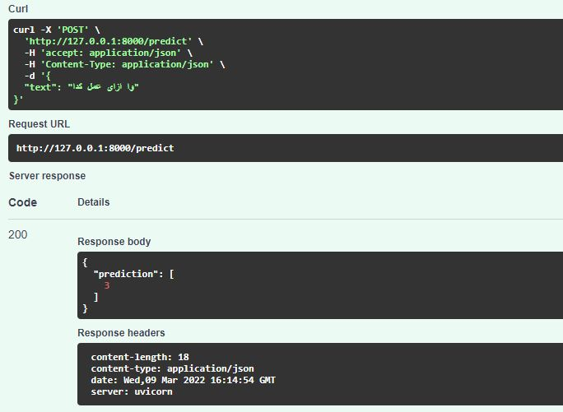
5- Deployment:
Machine learning: used FastApi to deploy the machine learning model and tried an example using Egyptian dialect.

Slide 7
FINAL Thoughts
After looking at the results of my ML model and comparing it to my DL model I found that the ML model have better results for some reason but maybe the DL model was fully trained and could have got better results than this, that's when I started to read the paper provided within the task and found out that the authors achieved an accuracy of 60% using BERT and ARABERT and superior methods of preprocessing and NLP than the ones I tried here, turns out that this problem is a tedious one because of the complexity of the Arabic language of course but also due to the large similarities between certain Arabic dialects which confuses the model as it search's for a pattern and also labeling consistency is also a problem that’s worth mentioning here as well.

Slide 8
THANK YOU

